Slide 1


<Augustine Chan>
<13/03/2025>

Slide 2

Outline
Executive Summary
Introduction
Methodology
Results
Conclusion
Appendix

Slide 3
Executive Summary
Summary of methodologies
Summary of all results

Slide 4
Introduction
Space Y is a new company set out to compete with Space X
Space X is competitive due to their new rocket technologies and ability to reuse rockets (by landing them without damage)
Space Y tasked me to develop a machine learning model that can predict a successful Stage 1 recovery

Slide 5

Section 1

Slide 6
Methodology
Executive Summary
Data collection methodology:
Data taken from SpaceX public API and SpaceX Wikipedia page
Perform data wrangling
Classifying true landings as successful and false as unsuccessful
Perform exploratory data analysis (EDA) using visualization and SQL
Perform interactive visual analytics using Folium and Plotly Dash
Perform predictive analysis using classification models
Models made using GridSearchCV

Slide 7
Data Collection
Data collected from Space X Public API and web scraping data from SpaceX Wikipedia
Space X API Data Columns:
FlightNumber, Date, BoosterVersion, PayloadMass, Orbit, LaunchSite, Outcome, Flights, GridFins,
Reused, Legs, LandingPad, Block, ReusedCount, Serial, Longitude, Latitude
Wikipedia Webscrape Data Columns:
Flight No., Launch site, Payload, PayloadMass, Orbit, Customer, Launch outcome, Version Booster, Booster landing, Date, Time

Slide 8
Data Collection – SpaceX API
Dictionary relevant data
Dictionary to Dataframe
Request
Json_normalize transformed into JSON Data
Filter data for Falcon 9 launches
JSON file and lists
Imputate missing PayloadMass values using Mean

Slide 9
Data Collection - Scraping
https://github.com/WatchaLookinAtb/IBM-Data-Science-Capstone/blob/main/jupyter-labs-webscraping.ipynb
Request from Wikipedia
Create Dictionary
Iterate and extract data to dictionary
Cast dictionary to DataFrame
BeautifulSoup Parsing

Slide 10
Data Wrangling
Make a training label for successful (1) and unsuccessful (0) landing outcomes
Outcome column composed of Mission Outcome and Landing Location
True ASDS, True RTLS and True Ocean are successful: 1
None None, False ASDS, False Ocean, False RTLS are unsuccessful: 0
https://github.com/WatchaLookinAtb/IBM-Data-Science-Capstone/blob/main/labs-jupyter-spacex-Data%20wrangling.ipynb

Slide 11
EDA with Data Visualization
EDA on Flight Number, Payload Mass, Launch Site, Orbit, Class and Year variables
Plots (found below) are Payload Mass vs. Launch Site, Flight Number vs. Payload Mass, Flight Number vs. Launch Site, Orbit vs. Success Rate, Flight Number vs. Orbit, Payload vs Orbit, and Success Yearly Trend
Different kinds of plots used, including scatter plots, line chars and bar plots
https://github.com/WatchaLookinAtb/IBM-Data-Science-Capstone/blob/main/edadataviz.ipynb

Slide 12
EDA with SQL
IBM DB2 Database used
SQL Python integration
Queries made about launch site names, mission outcomes, various pay load sizes of customers and booster versions, and landing outcomes
https://github.com/WatchaLookinAtb/IBM-Data-Science-Capstone/blob/main/jupyter-labs-eda-sql-coursera_sqllite.ipynb

Slide 13
Build an Interactive Map with Folium
Folium maps indicate Launch Sites, successful and unsuccessful landings, and a proximity example to key locations: Railway, Highway, Coast, and City.
https://github.com/WatchaLookinAtb/IBM-Data-Science-Capstone/blob/main/lab_jupyter_launch_site_location.ipynb

Slide 14
Build a Dashboard with Plotly Dash
The dashboard features a pie chart and a scatter plot to analyze SpaceX launch success.
The pie chart visualizes landing success rates, allowing users to view overall success across all sites or filter by a specific launch site.
The scatter plot explores the relationship between launch success, payload mass (0–10,000 kg), and booster version category, with interactive filters for site selection and payload range.
These visualizations provide both high-level insights and detailed analysis, helping users identify patterns in SpaceX’s launch performance.
For external reference and peer review, the completed Plotly Dash Lab is available on GitHub: https://github.com/WatchaLookinAtb/IBM-Data-Science-Capstone/blob/main/spacex_dash_app.py .

Slide 15
Predictive Analysis (Classification)
GridSearchCV (cv=10) to find optimal parameter
Use GridSearchCV on LogReg, SVM, Decision Tree, and KNN Models
Split Label Column, ‘Class’ from dataset
Train_test_split data
Score models on split test set
Standard Scaler to Fit and Transform
Confusion Matrix for all models
https://github.com/WatchaLookinAtb/IBM-Data-Science-Capstone/blob/main/SpaceX_Machine%20Learning%20Prediction_Part_5.ipynb
Imputate missing PayloadMass values using Mean
Barplot to compare scores of model

Slide 16
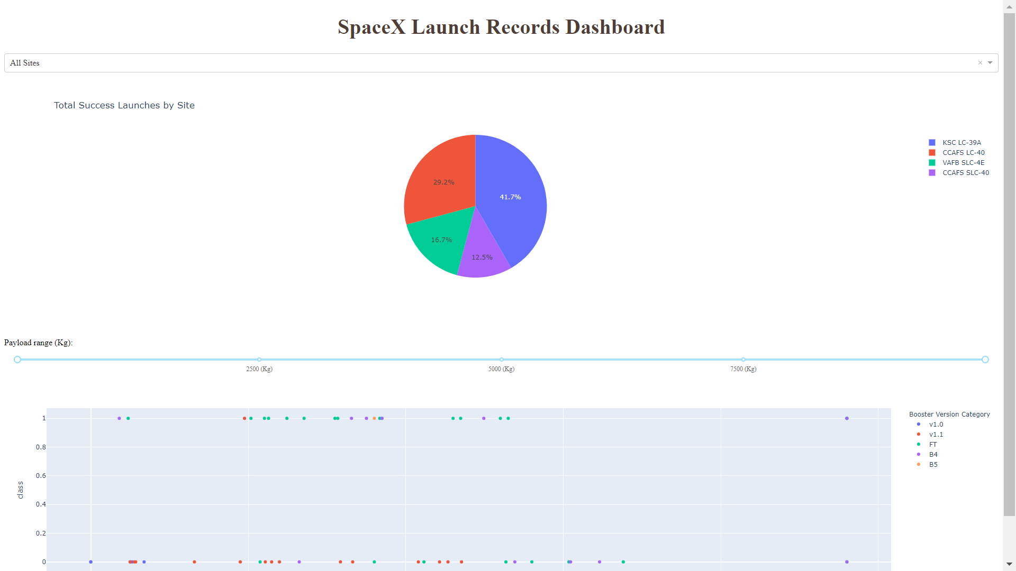
Results
This preview showcases the Plotly dashboard. The upcoming slides will present the results of Exploratory Data Analysis (EDA) using visualizations and SQL, an interactive map created with Folium, and the final model’s performance, achieving approximately 83% accuracy.

Slide 17

Section 2

Slide 18
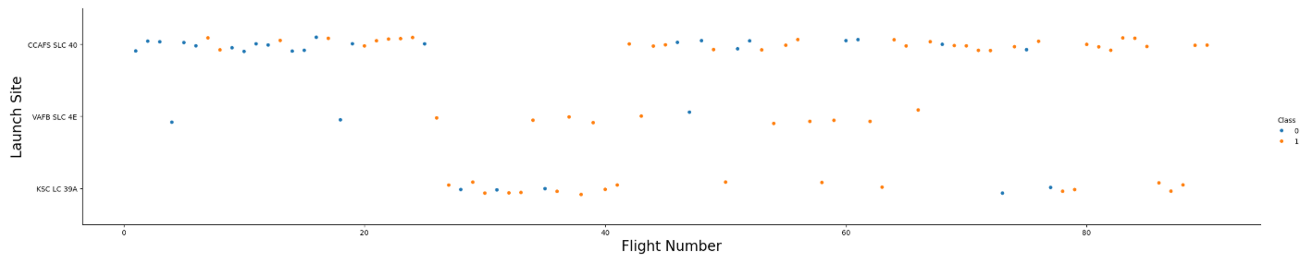
Flight Number vs. Launch Site
Success rate has increased over time, with a major breakthrough around Flight 20.
Success has generally risen since 2013, peaking at ~80% in recent years, despite a slight dip in 2018.
Green: successful launch;
Blue: unsuccessful launch

Slide 19
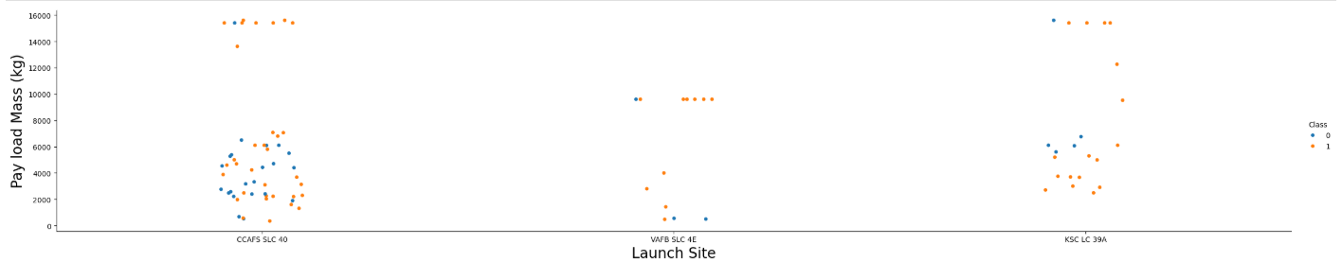
Payload vs. Launch Site
Most payloads fall between 0-6000 kg.
Different launch sites use distinct payload mass ranges
Show a scatter plot of Payload vs. Launch Site
Show the screenshot of the scatter plot with explanations

Slide 20
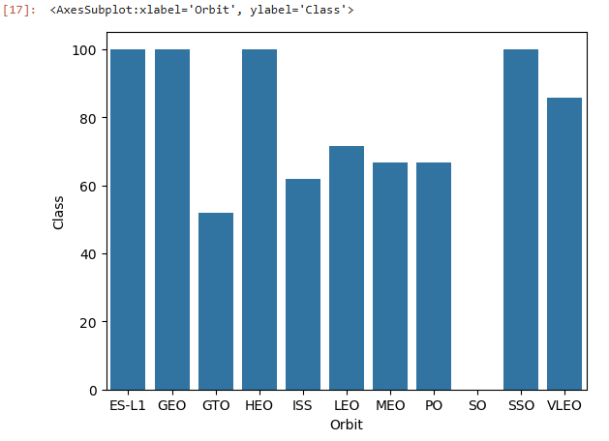
Success Rate vs. Orbit Type
100% success rates: ES-L1 (1), GEO (1), HEO (1), SSO (5).Decent success rate & attempts: VLEO (14).Low success rate: SO (1) - 0%.Largest sample size, ~50% success: GTO (27).SpaceX initially focused on LEO (moderate success) and later shifted towards VLEO & SSO, where performance improved.

Slide 21
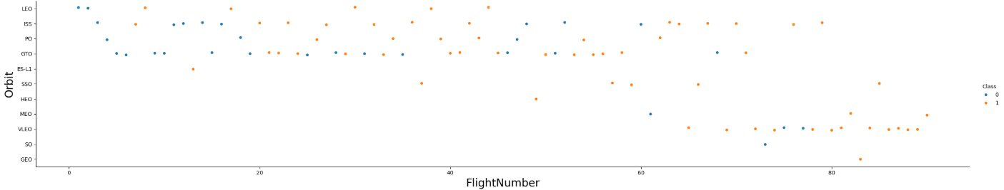
Flight Number vs. Orbit Type
Preferences Changed as Flight Number increased
SpaceX initially focused on LEO (moderate success) and later shifted towards VLEO & SSO, where performance improved.

Slide 22
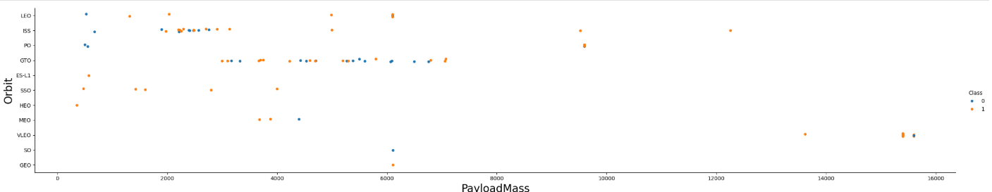
Payload vs. Orbit Type
Payload mass is linked to orbit type:LEO & SSO: Lower payload mass.VLEO (successful orbit): Heavier payloads at the higher end of the range.

Slide 23
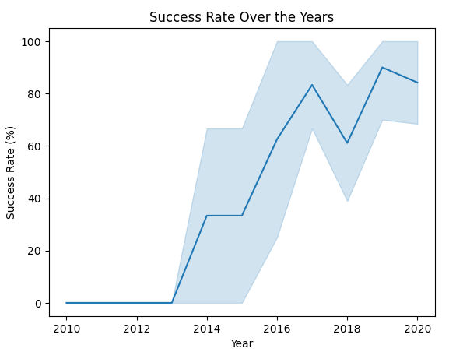
Launch Success Yearly Trend
Success increases over time since 2013 with a slight dip in 2018
Success in recent years at ~ 80%

Slide 24
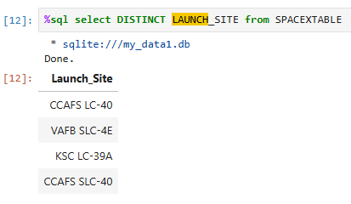
All Launch Site Names
CCAFS SLC-40 and CCAFSSLC-40 likely represent the same launch site.
Likely only 3 unique launch_site values: CCAFS SLC-40, KSC LC-39A, VAFB SLC-4E

Slide 25
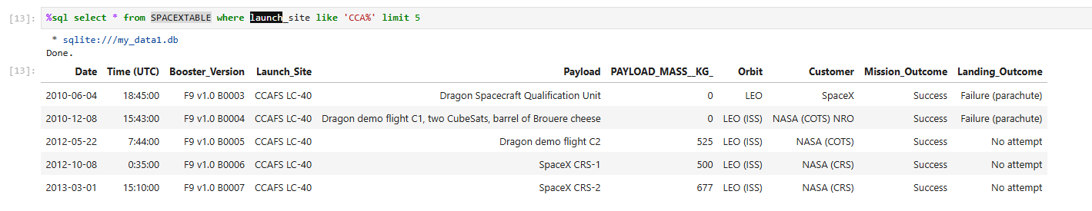
Launch Site Names Begin with 'CCA'
5 records where launch sites begin with `CCA`

Slide 26
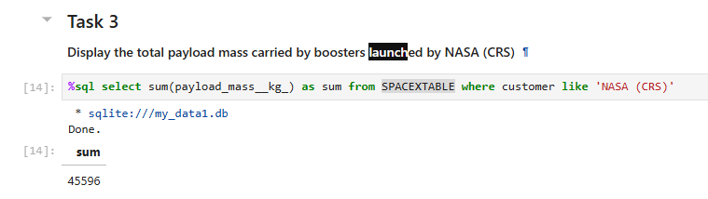
Total Payload Mass
A query calculating total payload mass for NASA missions confirms that CRS missions were meant for ISS resupply.

Slide 27
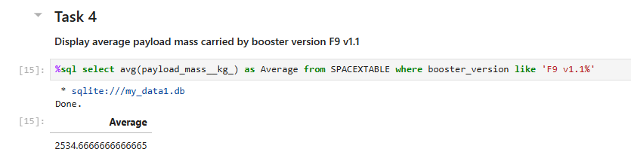
Average Payload Mass by F9 v1.1
This query calculates the average payload mass of launches which used booster version F9 v1.1

Slide 28
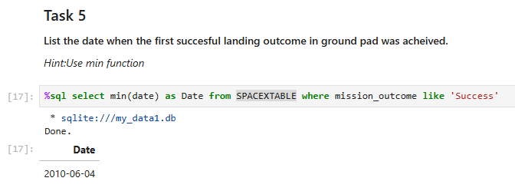
First Successful Ground Landing Date
This query returns the first successful ground pad landing date.
First ground landing wasn’t until the end of 2010.

Slide 29
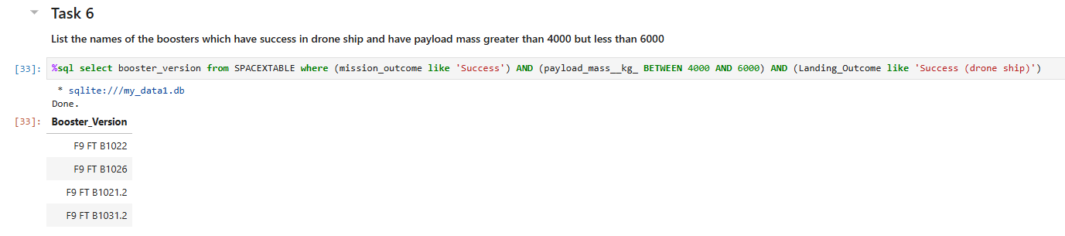
Successful Drone Ship Landing with Payload between 4000 and 6000
This query returns the names of boosters which have successfully landed on drone ship and had payload mass greater than 4000 but less than 6000

Slide 30
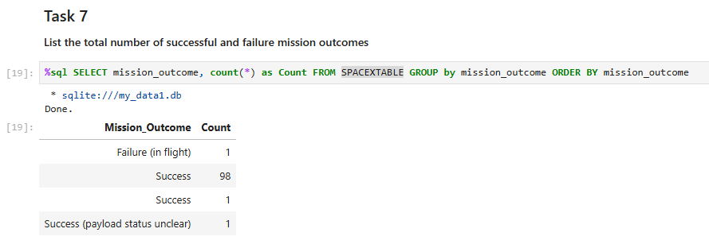
Total Number of Successful and Failure Mission Outcomes
Calculate the total number of successful and failure mission outcomes
Present your query result with a short explanation here

Slide 31
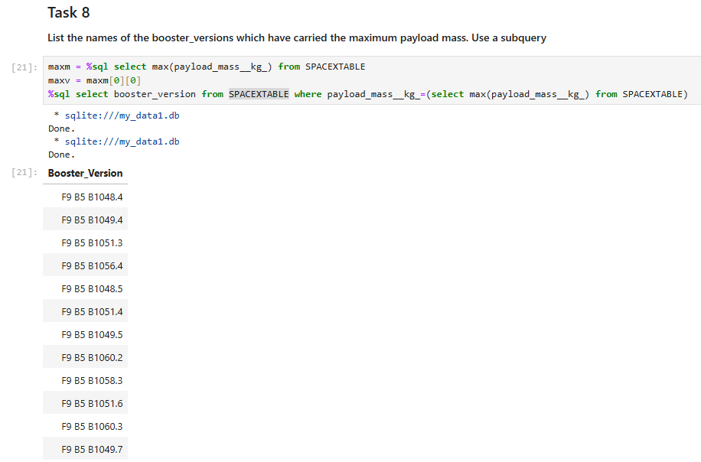
Boosters Carried Maximum Payload
This query returns booster versions which carried the highest payload mass of 15600 kg.
These booster versions are all F9 B5 B10xx.x.
This likely indicates certain booster versions consistently carried the maximum payload

Slide 32
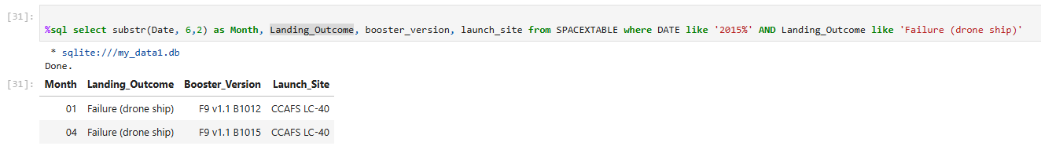
2015 Launch Records
This query returns the Month, Landing Outcome, Booster Version, Payload Mass (kg), and Launch site of launches in 2015 where stage 1 failed to land on a drone ship.

Slide 33
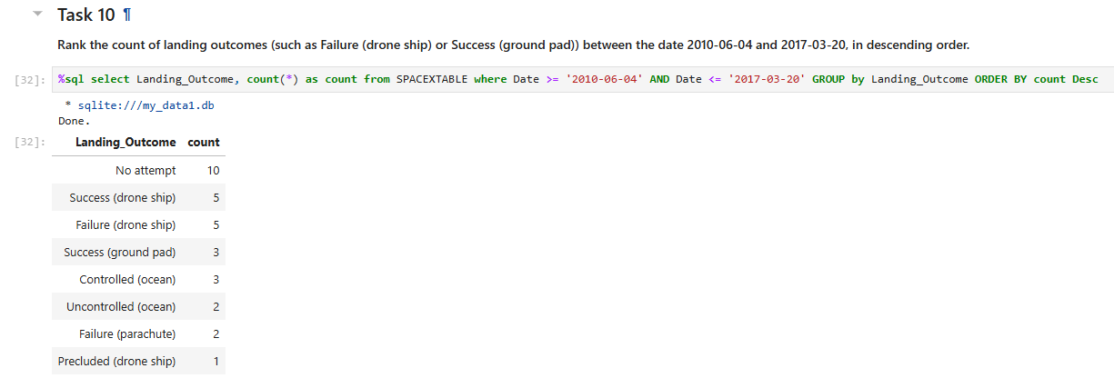
Rank Landing Outcomes Between 2010-06-04 and 2017-03-20
This query returned a list of ranked landing outcomes between June 4 2010 and March 20 2017

Slide 34

Section 3

Slide 35
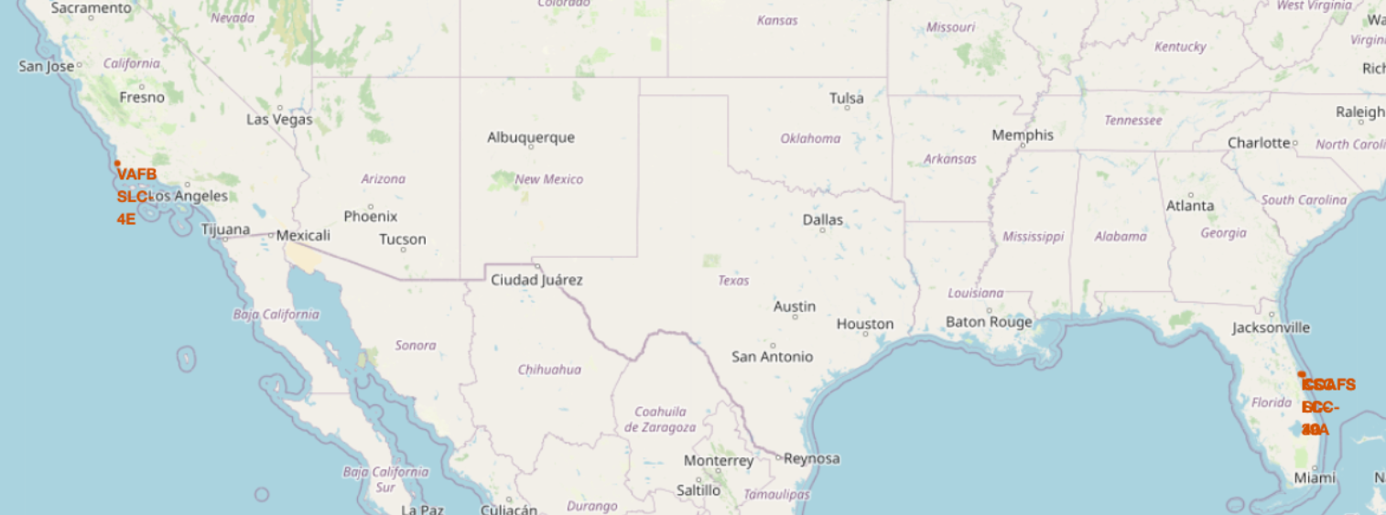
<Folium Map Screenshot 1>
The left map displays all the launch sites in relation to the US map, while the right map zooms in on the two Florida-based launch sites, given their proximity to each other. All launch sites are situated near the coast.

Slide 36
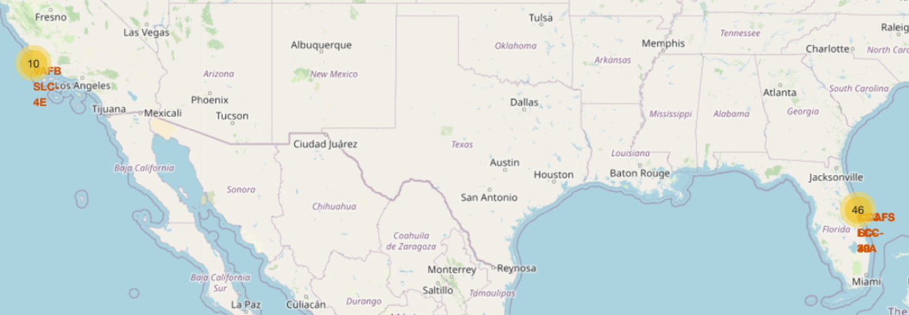
<Folium Map Screenshot 2>
On the Folium map, users can click on clusters to view individual landing events, with green icons indicating successful landings and red icons representing failed ones. For example, VAFB SLC-4E has 4 successful landings and 6 failed ones.

Slide 37
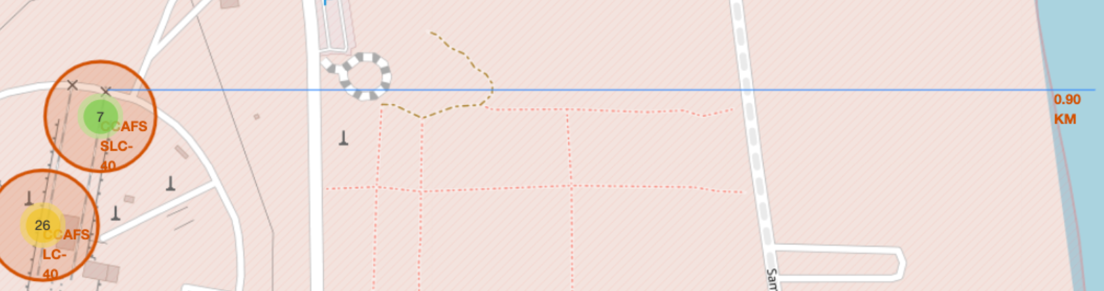
<Folium Map Screenshot 3>
Taking KSC LC-39A as an example, launch sites are typically located near railways for efficient transportation of large equipment and supplies. They are also close to highways for human and supply transport, and positioned by coasts to minimize risk to populated areas in case of launch failure.

Slide 38

Section 4

Slide 39
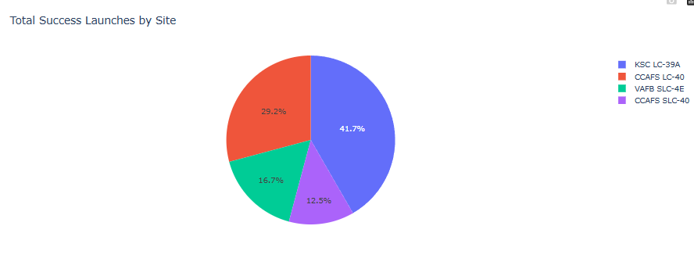
<Dashboard Screenshot 1>
The distribution of successful landings across all launch sites shows that CCAFS LC-40, now known as CCAFS SLC-40, has the same number of successful landings as KSC. However, most successful landings occurred before the name change. VAFB has the smallest share of successful landings, which could be due to a smaller sample size and the increased difficulty of launching from the West Coast.

Slide 40

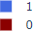
<Dashboard Screenshot 2>
KSC LC-39A has the highest success rate, with 10 successful landings and 3 failed ones.

Slide 41
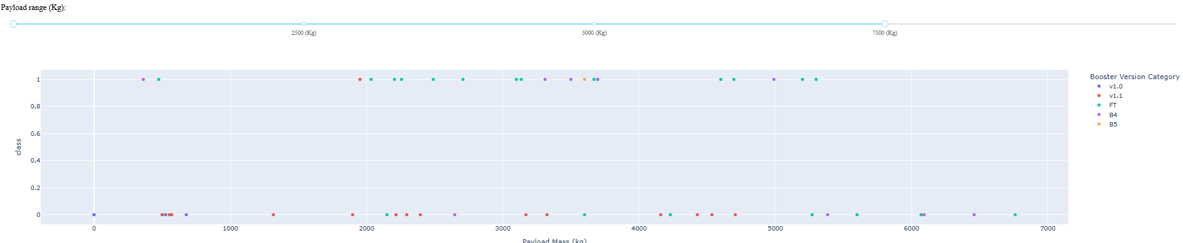
<Dashboard Screenshot 3>
The Plotly dashboard includes a Payload range selector, but it is set from 0-10000, rather than the actual max payload of 15600. Class indicates success (1) or failure (0). The scatter plot considers booster version, with the point size reflecting the number of launches. Interestingly, within the 0-6000 payload range, there are two failed landings with a payload of 0 kg.

Slide 42

Section 5

Slide 43
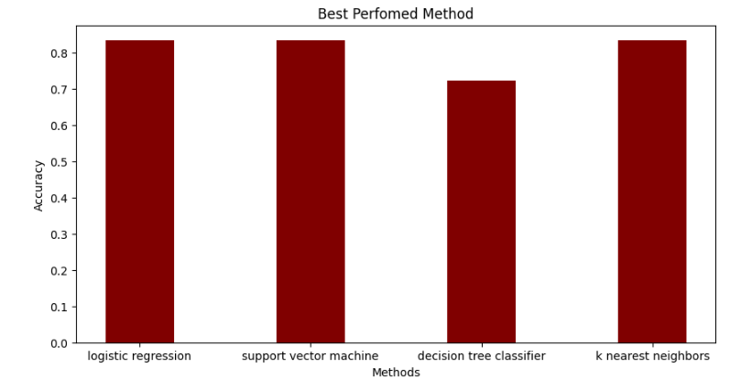
Classification Accuracy
All machine learning models except decision tree classifier had nearly identical performance on the test set, each achieving 83.33% accuracy. However, with only 18 samples, the test size is small, which can lead to high variability in accuracy, as seen in the Decision Tree Classifier model during repeated runs. More data is needed to improve model reliability.

Slide 44
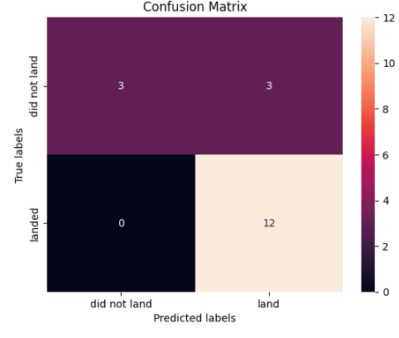
Confusion Matrix
Since 3 models performed similarly on the test set, their confusion matrices were identical. The models correctly predicted 12 successful landings, 3 unsuccessful ones, and falsely predicted 3 successful landings when the true outcome was unsuccessful (false positives). The models tend to over-predict successful landings.

Slide 45
Conclusions
Our goal was to develop a machine learning model for SpaceY, aiming to predict successful Stage 1 landings and potentially save ~$100 million USD.
Data was gathered from a public SpaceX API and a web scraping of SpaceX’s Wikipedia page, and stored in a DB2 SQL database.
A dashboard was created for visualization, and a machine learning model achieved an accuracy of 83%.
SpaceY can use this model to predict whether a launch will result in a successful Stage 1 landing, helping them decide if the launch should proceed.
Collecting more data will likely enhance model accuracy and refine predictions.

Slide 46
Appendix
GitHub Repository: https://github.com/WatchaLookinAtb/IBM-Data-Science-Capstone/tree/main
Thank you for looking through!

Slide 47


